Slide 1

Cloud Compute and Networking Services

Slide 2
Compute Services
Compute services provide dynamically scalable compute capacity in the cloud.
Compute resources can be provisioned on-demand in the form of virtual machines.
Virtual machines can be created from standard images provided by the cloud service provider (e.g., Ubuntu image and Windows server image) or custom images created by the users.
A machine image is a template that contains a software configuration (operating system, application server, and applications).

Slide 3
Examples of Cloud Compute and Networking Services
Amazon EC2
AWS EC2 Auto Scaling
AWS Elastic Load Balancing
Amazon Virtual Private Cloud (VPC)

Slide 4
Examples of Cloud Compute and Networking Services
Amazon EC2
AWS EC2 Auto Scaling
AWS Elastic Load Balancing
Amazon Virtual Private Cloud (VPC)

Slide 5
Amazon EC2
Amazon EC2 is an Infrastructure-as-a-Service (IaaS) provided by Amazon.
EC2 delivers scalable, pay-as-you-go compute capacity in the cloud.
EC2 is a web service that provides computing capacity in the form of virtual machines that are launched in Amazon’s cloud computing environment.

Slide 6
Instance
A virtual machine (VM) or a specific configuration of computing resources allocated for a particular purpose - including CPU, memory, storage, and network
Cloud providers offer various types of instances optimized for different use cases

Slide 7
EC2 Instance Types
General Purpose: The general purpose instances provide a balance of compute, memory, and network resources, and are well suited for a wide range of applications. Within the general purpose type, there are various families such as M4, M5, M5a, T2, T3, and A1.
Compute Optimized: The compute optimized instances are optimized for compute-intensive workloads and deliver cost-effective high performance at a low price per compute ratio. Within the compute optimized type, there are various families such as C4, C5, and C5n.
Memory Optimized: The memory optimized instances are optimized for memory-intensive applications. Within the memory optimized type, there are various families such as R4, R5, R5a, R5a, X1, X1e, and z1d.
Accelerated Computing: The accelerated computing instances are intended for graphics and general-purpose GPU compute applications. Within the accelerated computing type, there are various families such as P2, P3, G3, and F1.
Storage Optimized: The storage optimized instances are optimized for workloads that require high disk throughput. Within the storage optimized type, there are various families such as H1, I3, and D2.

Slide 8
Machine Image
Aa snapshot or template of a virtual machine's configuration, including the operating system, software applications, configurations, and possibly data
It serves as a blueprint for creating new instances or virtual machines with identical configurations
Machine images are created to capture a specific state or configuration of a virtual machine at a particular point in time.
They are used for consistency, replication, and scalability. When you want to deploy multiple instances with the same setup, you use a machine image.

Slide 9
Amazon Machine Image
Amazon Machine Image (AMI) is an instance template that contains the software configuration (including operating system and applications) required to launch an instance.
AMIs are based on Linux or Windows operating systems.
AMIs can come from different sources such as:
AMIs published by AWS
AWS marketplace
Community AMIs
Your own AMIs created from existing instances

Slide 10
Security groups
Security groups play a crucial role in securing instances in AWS by controlling the traffic flow to and from them.
It's important to carefully design and configure security groups to meet the specific security and networking needs of your applications.

Slide 11
EC2 Security Groups
A security group is like a virtual firewall that allows you to control the traffic coming in and going out of your instances.
By default, all incoming traffic is denied for an instance.
Within a security group, you can define rules to allow traffic based on port, protocol, and source or destination.

Slide 12
EC2 Tenancy Options
Amazon EC2 supports the following tenancy options for the instances:
Shared Tenancy: Shared tenancy is the default tenancy model for all EC2 instances. In this model, the instances run on shared hardware. Therefore a single host can host instances from different customers.
Dedicated Instances: Dedicated instances run on a single-tenant hardware, which means that the hardware is dedicated to a single customer.
Dedicated Hosts: In the dedicated hosts model, the instance runs on a Dedicated Host, which is an isolated physical server solely dedicated to a single customer.

Slide 13
Dedicated Hosts vs Dedicated instances
You can use Dedicated Hosts and Dedicated instances to launch Amazon EC2 instances on physical servers that are dedicated for your use.
An important difference between a Dedicated Host and a Dedicated instance is that a Dedicated Host gives you additional visibility and control over how instances are placed on a physical server, and you can consistently deploy your instances to the same physical server over time.
As a result, Dedicated Hosts enable you to use your existing server-bound software licenses and address corporate compliance and regulatory requirements.

Slide 14
Pricing
EC2 instances are charged per hour or per second while they are running.
This means that when we don’t need them, we should shut them down.
In general, the more resources you consume on EC2, the more you pay.
However, the sum of money that you pay to consume a certain amount of resources can vary greatly depending on which type of EC2 pricing model you use.

Slide 15
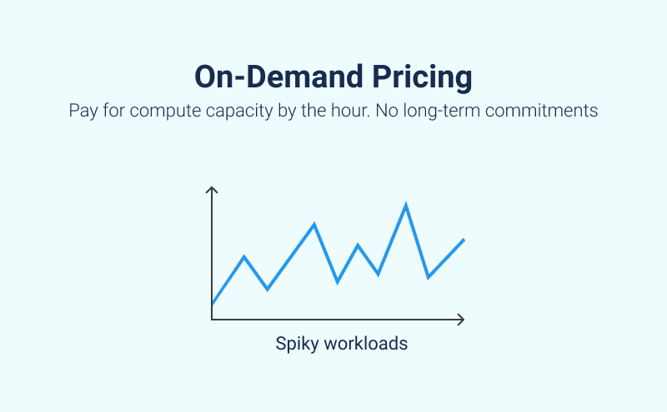
EC2 Pricing Options
On-Demand Instances
On-demand instances do not have any upfront costs or commitments
Users are charged for the running instances on an hourly basis

Slide 16
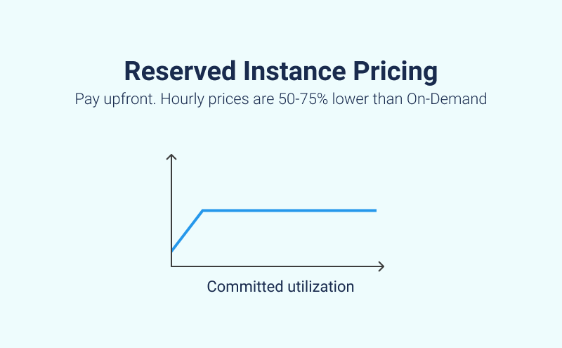
EC2 Pricing Options
Reserved Instances: Reserved Instances are recommended for long term use or predictable workloads where you can save significantly on the costs of running the instances by purchasing reserved instances. For reserved instances, the payment can be made either all-upfront for the entire term, partial-upfront or no-upfront.

Slide 17
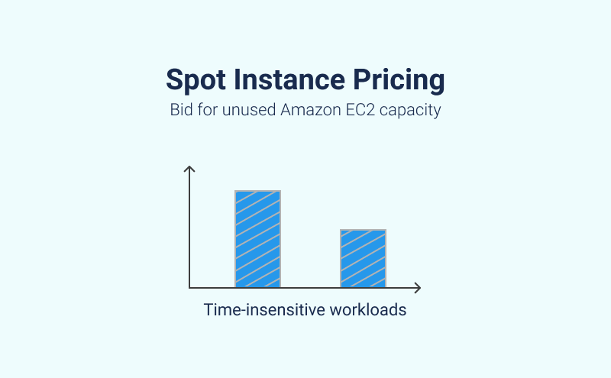
EC2 Pricing Options
Spot Instances: With spot instances, you can specify the price that you are willing to pay for a certain instance type. You bid for unused Amazon EC2 capacity
Spot instance pricing is not a good option for Amazon EC2 workloads that you run an on an ongoing basis because spot instances are less predictable, and the work required to bid on spot instances is significant.
However, if you know that you are going to host a particularly resource-intensive workload for a temporary period and have flexibility regarding when that workload is run, or if you have free time available to bid on spot instances, this Amazon EC2 instance pricing model can deliver the greatest EC2 cost savings.

Slide 18
EC2 Placement Groups
Placement Groups allow you to define how your instances are placed on the underlying hardware. A placement group is a logical grouping of instances.
Cluster: A cluster placement group clusters instances into a low-latency group in a single availability zone.
Partition: A partition placement group spreads instances across logical partitions, ensuring that instances in one partition do not share underlying hardware with instances in other partitions.
Spread: A spread placement group spreads instances across underlying hardware.

Slide 19
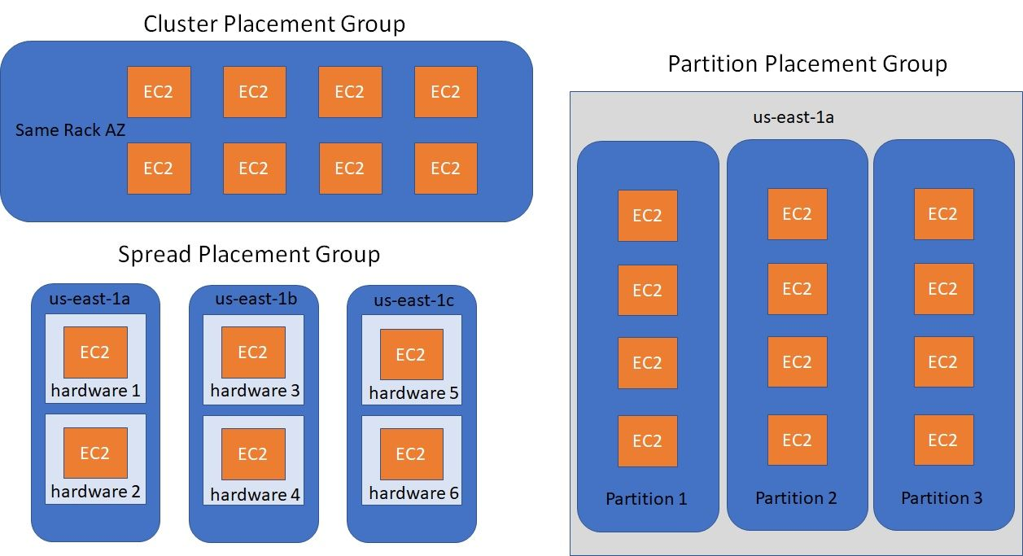

Slide 20
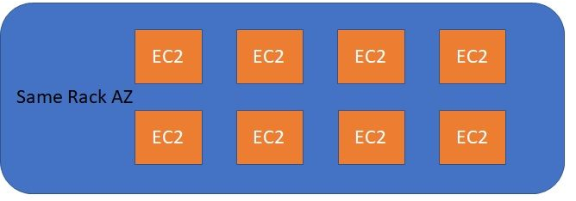
Cluster Placement Group
Definition: A cluster placement group is a logical grouping of instances within a single Availability Zone. Instances in the same cluster placement group are placed in close proximity to each other, providing low-latency networking between them.
Use Case: This is beneficial for applications that require extremely low-latency communication between instances, such as high-performance computing (HPC) applications.

Slide 21
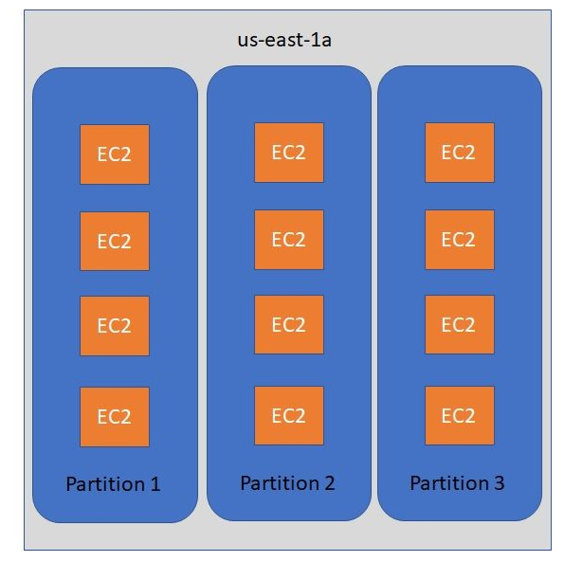
Partition Placement Group
Definition: A partition placement group is another logical grouping, but it spreads instances across many racks. Each partition within the group represents a logical segment of the overall capacity. Partitions do not share the same rack, providing a degree of fault tolerance.
Use Case: This type of placement group is suitable for distributed and replicated workloads that benefit from spreading instances across different physical hardware to reduce the risk of simultaneous hardware failures.

Slide 22
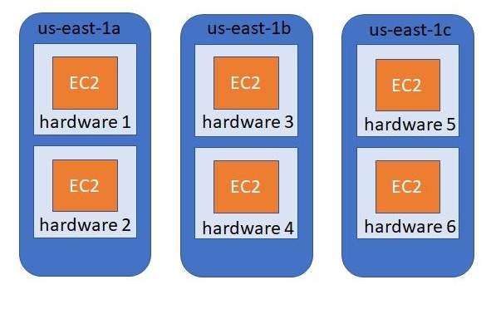
Spread Placement Group
Definition: A spread placement group is designed to spread instances across underlying hardware to reduce the risk of correlated failures. Instances in a spread placement group are placed on distinct racks, ensuring that they are physically separate from each other.
Use Case: Ideal for applications that require high availability by minimizing the impact of hardware failures. It's a good choice for critical applications that need redundancy and fault tolerance.

Slide 23
Examples of Cloud Compute and Networking Services
Amazon EC2
AWS EC2 Auto Scaling
AWS Elastic Load Balancing
Amazon Virtual Private Cloud (VPC)

Slide 24
AWS EC2 Auto Scaling
AWS EC2 Auto Scaling service allows automatic scaling of Amazon EC2 capacity up or down according to user-defined conditions.
Therefore, with AutoScaling users can increase the number of EC2 instances running their applications seamlessly during spikes in the application workloads to meet the application performance requirements, and scale down capacity when the workload is low to save costs.

Slide 25
Auto Scaling Launch Configuration
A Launch Configuration is a template that is used by the Auto Scaling service to launch new instances within an Auto Scaling Group.
A Launch Configuration comprises AMI, instance type, security group, and key pair.

Slide 26
Auto Scaling Group
An Auto Scaling Group is a collection of instances that are managed by the Auto Scaling service.
An Auto Scaling Group comprises a configuration such as a launch configuration to launch new instances within the group, desired capacity, maximum capacity, and scaling policies.

Slide 27
Scaling Policy
Scaling policies can be defined for an Auto Scaling Group which define how to adjust the capacity dynamically.
Amazon EC2 Auto Scaling supports the following types of scaling policies:
Target tracking scaling: With this policy, you can increase or decrease the current capacity of the group based on a target value for a specific metric (such as CPU utilization or network traffic)
Step scaling: With this policy, you can increase or decrease the current capacity of the group based on a set of scaling adjustments, known as step adjustments, that vary based on the size of the alarm breach.
Simple scaling: With this policy, you can increase or decrease the current capacity of the group based on a single scaling adjustment.

Slide 28
Target tracking scaling - example
Let’s say that you currently have an application that runs on Spot Fleet (In Amazon Web Services (AWS), a Spot Fleet is a collection or fleet of Spot Instances), and you want the CPU utilization of the fleet to stay at around 50 percent when the load on the application changes. This gives you extra capacity to handle traffic spikes without maintaining an excessive number of idle resources.

Slide 29
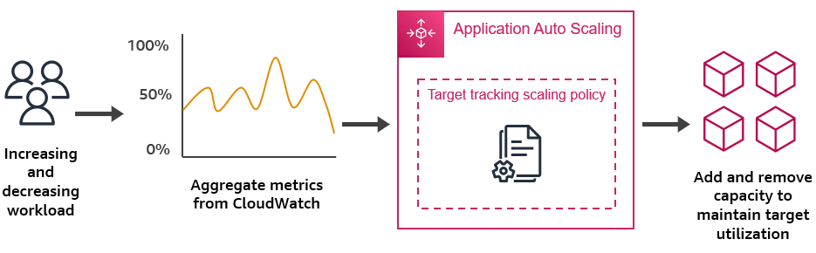
Target tracking scaling - example
You can meet this need by creating a target tracking scaling policy that targets an average CPU utilization of 50 percent. Then, Application Auto Scaling will scale out (increase capacity) when CPU exceeds 50 percent to handle increased load. It will scale in (decrease capacity) when CPU drops below 50 percent to optimize costs during periods of low utilization.

Slide 30
Step scaling example
You can define different step adjustments based on the breach size of the alarm. For example:
Scale out by 10 capacity units if the alarm metric reaches 50 percent
Scale out by 30 capacity units if the alarm metric reaches 75 percent
Scale out by 40 capacity units if the alarm metric reaches 85 percent
When the alarm threshold is breached for the specified number of evaluation periods, Application Auto Scaling will apply the step adjustments defined in the policy. The adjustments can continue for additional alarm breaches until the alarm state returns to OK.

